Slide 1
Principle-Based Natural Language Processing
Eliminating the Shortcomings of Rule-based Systems with Statistics
Wen-Lian Hsu
Institute of Information Science
Academia Sinica, Taiwan

Slide 2
A Brief Self-Introduction
Consider myself a layman to the linguistic community
BS in Math., PhD in Operations Research (OR)
  OR was adopted in WW II to plan military maneuvers, schedule resource allocation
1980, Move to research in computer algorithms.
1989, returned to Academia Sinica and started working on Chinese input method form the algorithmic viewpoint.

Slide 3
An example from
Chinese speech recognition (CSR)
CSR is difficult in that, even if the speech signal is perfectly recognized, the homophone selection is still hard.
The following is a machine learning approach (word bigram).
Markov assumption throws much of the history away!
Notes:
Assumption

Slide 4
An example from
Chinese speech recognition (CSR)
CSR is difficult in that, even if speech signal is perfectly recognized, the homophone selection is still hard.
The following is a machine learning approach (word bigram).
Difficult to model long distance constraints
This is a typical resource scheduling problem!

Slide 5
Outline
Introduction
Rule base or machine learning?
Principle-based approach
  Modeling context through frames
Pattern Reduction

Slide 6
A Central Theme in NLP
Recognize various linguistic expressions:
  Named entities, relations, events

Slide 7
Information Extraction from Medical Record
Record in a diabetic patient’s documentation:
This is the 1st visit of the patient to the clinic with complaints of general weakness, acetonoria, HBP, and sickness since few days. The disease was detected 4 years ago by the high blood sugar measurement, made because of a face rash. Despite of the treatment with Maninil and Diaprel there are no changes for better.
Notes:
7
一個簡單的病例例子
如何從文字敘述的病例中取得相關的病歷資訊
7

Slide 8
Extracted Medical Record
After information extraction
Symptoms - weakness, acetonoria, HBP, sickness
Diagnosis - diabetes
Treatment - drugs: Maninil and Diaprel
Result - there are no changes for better
Notes:
8
8

Slide 9
International Competitions (2006 ~)
We have tried to combine machine learning and rule-based approach in practical systems, e.g. question answering, word segmentation, NER
  To explore the limits of various models
1st/13 in the WS CityU closed track of the SIGHAN 2006 Word Segmentation (97.2%) – CRF
2nd/8 in the NER CityU closed track of the SIGHAN 2006 Named Entity Recognition (88%) - ME
1st/8 in the NTCIR6 2007 CLQA Chinese Question Answering (57%) – SVM, ME, InfoMap
1st in the NTCIR6 2007 CLQA English-to-Chinese Question Answering (34%) - SVM, ME, InfoMap
1st/10 in BioCreAtIvE II.5 2009 Interactor Normalization Task
1st/9 in the NTCIR9 2011 Recognizing Inference in TExt (RITE) (66.1%)
1st/8 in the NTCIR9 2013 Recognizing Inference in TExt (RITE) (67.1%)

Slide 10
Outline
Introduction
Rule base or machine learning?
Principle-based approach
  Modeling context through frames
Pattern Reduction

Slide 11
The war between probabilistic vs. rule-based models
Before 1990, rule-based models dominated NLP
Then comes the age of corpus analysis and probabilistic models. People believe all linguistic knowledge (or features) can be found in corpus; it is a matter of assigning proper weights to various linguistic features in NLP applications based on training corpus.
However, both models have their weaknesses.

Slide 12
Potential limitations of current machine learning models
Features are normally represented as vectors. Their weights are fixed
  Cannot reflect the current context
Features are usually assumed to be independent
  However, feature collocation is essential in natural language
Markov process can only model local constraints
  Local features outweighs long distance ones
Feature weights are less portable (non-accumulative).
  Need (accurate) annotated data for training in every domain
  Learn from scratch; annotation is very time consuming
Difficult to incorporate fine-grained linguistic knowledge
  Joke: For every linguist fired the system accuracy gets higher
Notes:
In biomedical area, to annotate disease-gene relations, need annotated data for every disease. It is difficult to transfer from one disease to another.

Slide 13
Drawbacks of Rule-based models
Rules are manually crafted
  Time consuming, subjective with poor coverage
Rules must be matched exactly (very rigid)
  Hard to handle exceptions and variations
Rules often create conflicts
  Linguists often argue against each other
Is there any way to change this situation?

Slide 14
Fundamental Issues in AI
Computer and Human Cognition
Computer
  Exact matching
  Very strict and precise
  Fail to see the wood for the trees (見樹不見林)
  Training set must be professionally annotated
Human
  Flexible matching
  Make mistakes sometimes
  Can deduce many things from one case (舉一反三)
  Learn by analogy

Slide 15
Characteristics of
Linguistic Pattern Matching
If the algorithm is very rigid, then you need to collect a lot of patterns to cover exceptions and variations.
Could always miss some cases in the test set or in the real world.
If the algorithm is more flexible, then you are running the risk of getting lower precision.
Our principle-based approach is designed to be flexible and precise by adopting intensive linguistic and domain knowledge

Slide 16
Outline
Introduction
Rule base or machine learning?
Principle-based approach
  Modeling context through frames
Pattern Reduction

Slide 17
How can we do Robust Matching?
Rules are more likely to be similar in different domains provided they can be matched approximately
  An analogy in human language learning
    Students are given a few grammar rules and then read a lot of examples (gathering knowledge statistically) to master them
Fuzzify the concept representation so that it is more coherent with human cognition. →
  Allow proper insertion, deletion, substitution, permutation and partial matching in rule matching (exception handling)
Use statistical learning to semi-automatically collect
  basic grammar rules or semantic patterns (called frames)
  required knowledge for exception scoring.

Slide 18
An example of homophone selection
Unlikely to accomplish without structural knowledge
一隻可愛的小花貓
A lovely little cat
一枝可愛的小花
A lovely little flower
一支可愛的小鉛筆
A lovely little pencil
A rule
[digit]:[quant]:[adj]:[noun]
But it is difficult to handle
[quant] ~ [noun]
insertion
一隻隻可愛的小花貓
一隻可愛又淘氣的小花貓
We can model such a simple NP with
contextual insertion, deletion and etc.
deletion
一隻小花貓
substitution
一隻可艾的小花貓
User’s error
permutation
隻一可愛的小花貓

Slide 19
Frame-based Patterns
A frame is a linguistic object that binds other objects together through semantic and syntactical constraints
  A structure formed by frequently collocated words
Build frames for meaningful chunks in text
Noun phrase:
  A lovely little cat
  一 隻 可愛的 小花貓
  [digit] [quant] [adj] [noun]
Frame structure
  Slots: digit, quantifier, adj., noun
  Relations:
  < [quant.], [noun] > agreement
Linguist writing rules would be very happy to see this.
To distinguish from rules, we refer to frame patterns as principles.
digit → quant. → adj. → noun
Notes:
Instead of asking when Jeremy Lin should do this and that, look for team strategies that can accommodate Jeremy Lin naturally.

Slide 20
Principle-based Approach
An example
Distant collocation is no accident.
The archaeologist is in trouble (people] : [be] : [in a situation]).
The old archaeologist named John is in a very serious trouble.
The old archaeologist named John Doe is in a very serious trouble with his academia reputation.
If we look at how sentences were generated step-by-step, principle-based approach can be regarded as (reverse engineering)
  Composing words and phrases into classes.
  Predicting the skeleton of the sentence
  Align the sentence with the skeleton (matching)

Slide 21
Outline
Introduction
Rule base or machine learning?
Principle-based approach
  Modeling context through frames
Pattern Reduction

Slide 22
Types of Frames
Frames are formed hierarchically.
Simple phrase: word, word combination
  They provide basic annotations for slots in complex frames
Complex phrase: e.g. named entity frame
Scenario frame:
  Word, phrase frame: meaning and usage of words
  Event frame
  Topic frame
  Frames provide the contextual information and constraints.

Slide 23
Flexible frame matching and scoring
From exact rule matching to approximate structural matching
Match frames in a bottom-up fashion: start from dictionary and semantic composition
Frame slots are retrieved from text disregarding order:
  Not all slots need to appear (deletion)
  Not all relations need to be satisfied (permutation)
  No need to envision everything beforehand (insertion)
    Additional words are allowed; fine-grained linguistic knowledge of can be incorporated to score sentence coherency
  A slot can appear with a certain probability (e.g. misspelling or OCR) (substitution or partial matching)
Notes:
Frame matching is very similar to information retrieval, and the scoring part can incorporate fine-grained linguistic knowledge
Can possibly cope with insertion, deletion, substitution and permutation
This is more in line with human cognition
A frame in which more linguistic knowledge can be accommodated (with higher score) is likely to be selected

Slide 24
Frame Knowledge
The magic about frame matching is that we can incorporate a lot of collocation agreements in our matching algorithm
  Distant collocation agreements are captured by structured frame elements
  Local, less frequent collocation are modeled through bigram Insertion with frame elements.
Frame elements
  To ensure a high pattern frequency, need to consider
    Semantic classes rather than surface words
    Further combine words and classes to form bigger classes.

Slide 25
Insertion Agreement
The Scoring Mechanism
How to score (evaluate) an Insertion?
  The more it agrees with the neighboring words the higher score it gets
    Calculate bigrams, contextual bigrams (collected within the context)
Examples:
  The level of protein in serum
  The serum level of protein
  The expression level of protein in serum
More linguistic and domain knowledge are needed
  Ontology provides valuable sources for frame elements.

Slide 26
Domain Ontology
Providing collocated words
Using the yeast two-hybrid system, we have isolated an 835 amino acid RING finger (C3HC4 zinc finger) protein, TIF1b (also named KAP-1), that specifically interacts with the KRAB domain of the human zinc finger factor KOX1/ZNF10.
yeast two-hybrid system is an experiment to detect protein-protein interaction。
amino acid, RING finger and KRAB domain are specific structures of protein.
Protein
Attribute
  Level
  Function
    Transducer
    Regulator
    Activator
    Inhibitor
    Factor
    Cofactor
    Substrate
    Ligand
  Structure
    Region
      Coiled-coil
    Motif
      Coiled-coil
      Zinc finger
    Domain
      RING finger
      Zinc finger
      Acidic domain
      Glycine-rich domain
      Proline-rich domain
    Amino acid
      List of 20 amino acids
Consider them as
friends in Facebook

Slide 27
Incorporating common sense
Common senses are not always shown in text.
  The (expression) level of protein in serum
  台北市(中心的)忠孝東路四段(上面的)12號
  It is hard to anticipate when and where the writer will insert common sense words or phrases.
  However, when they do appear, they are usually coherent with the surrounding text, which can be verified through bi-gram statistics.

Slide 28
Incorporating common sense
It is easier to find support for the insertion of common sense words and phrases later (but not earlier, say, at the stage of rule composition).
Principle-Based Approach is suitable for dealing with common sense words and phrases.

Slide 29

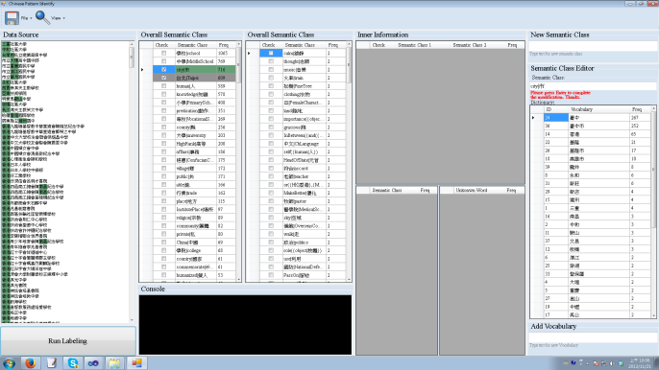


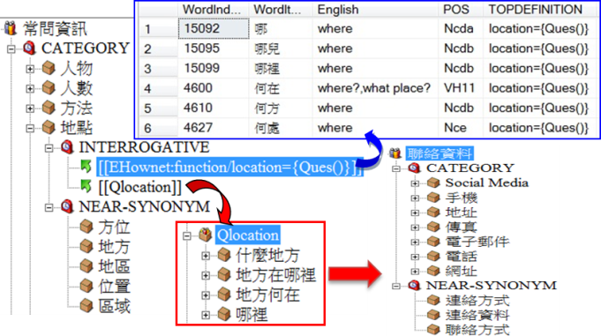
positive examples
Pattern Identification
Programmer
Semantic Group
Knowledge Construction
…
…
…
Organization Ontology
Address Ontology
Notes:
Positive example 是semi-supervised產生的：由programmer開發的程式自動取得(網頁、Wikipedia…)，也會由semantic group蒐集而來。 (如Gene Name 或是地址)
Programmer開發pattern identify tool (pattern generation)供semantic group使用，自動找出collocation、bigram, trigram等組合藉此找出positive example中的frequent pattern。並引入外部Knowledge resource(如Ehownet)來進行語意標註與定義。
透過pattern identify程序後，可以獲得domain中的frequent pattern，再透過InfoMap建立domain knowledge (如濟洋針對Bio所做的Map)

Slide 30
Principle-based approach
Example: Chinese Address Patterns
County : city : district : road : section : alley : lane : number
People write addresses in various ways
  With a lot of omissions
We used to adopt 30 rules to recognize addresses.
  Still, there were many cases we could not cover
  台北市(中心的)忠孝東路四段(上面的)12號
  City road section number
Deletions can be modeled through frame index.
We can now cover all cases by one frame

Slide 31
Example: Reference extraction
Volume, Issue, and Page number
Rule:
  V(I),P
  38(2), 115—126
  V(I):P
  38(2):115—126
  V.I:P
  38.2:115—126
  V,I,P
  38, 2, 115—126
  V:I,P
  38:2, 115—126
Frame (allow insertion):
  VIP
  38(2), 115—126
  38(2):115—126
  38.2:115—126
  38, 2, 115—126
  38:2, 115—126
One frame does it all !!

Slide 32
Example: Chinese time phrase
Consider a Chinese speech recognition case:
下 午 二 十 二 時 三 十 二 分
afternoon 22 hour 32 minute
There are 3 words with the same pronunciation (ten, hour)
Underlying frame:
afternoon : digit₁ : hour : digit₂ : minute
Since digits are dynamic variables, they can be treated as Insertions.
  Insertion agreement: digit₁ ≤ 24 ; digit₂ ≤ 60

Slide 33
Example 4: Chinese time phrase
Incorrect alignments will violate the collocation agreement
下 午 二 時 二 十 三 十 二 分
下 午 二 十 二 十 三 時 二 分
Correct hour

Slide 34
Outline
Introduction
Rule base or machine learning?
Principle-based approach
  Modeling context through frames
Pattern Reduction

Slide 35
Pattern Reduction
How many Frame Patterns do we need?
  We consider a large corpus with 10 million sentences that result in 300,000 sentence patterns (which would be hard to use as the rule set)
  theme [Verb] range
  agent evaluation time [Verb]
  theme time [Verb] complement
  contrast theme [Verb] range
In our frame reduction that allows insertion, deletion
  theme manner [Verb] range → theme [Verb] range
The best 60 patterns can cover 99%
Long tail effect

Slide 36
Pattern Reduction
Frame Patterns are Robust
In fact, if we only use 1/10-th of the sentences (chosen randomly) as the training set (i.e. 1 million sentences), and take the best 60 patterns, they will cover 98.5% of the entire pattern set.
This shows that the patterns learned are robust enough.

Slide 37
Principal Component Analysis (PCA)
Principal Pattern Analysis (PPA)
Principal component analysis (PCA) is a mathematical procedure that uses orthogonal transformation to convert a set of observations of possibly correlated variables into a set of values of linearly uncorrelated variables called principal components. PCA are often adopted for dimension reduction.
  Continuous world
In our principle-based approach, we have proposed a transformation that converts a set of patterns into a set of principal patterns that can cover most patterns.
  Discrete world

Slide 38
Conclusion
Principle-based approach (PBA) is interpretable, not difficult to maintain, provides more expressive power, and potentially can produce more accurate results.
Frame matching can be readily applied to speech signals (not just text input).
We hope PBA will open up a new avenue of research for natural language processing and speech recognition, that can help create
  More new algorithms
  More fine-grained knowledge adoption
  More research on linguistic knowledge that can be put to practical use

Slide 39
Conclusion
Similar phenomenon of combined rule and statistical inference are quite common in many other areas, such as music, speech, image, and video.
It would be interesting to see how PBA can be adapted to AI in general.

Slide 40
Acknowledgement
I would like to thank all members in my lab for putting up with my crazy idea at first, and cruising along with the necessary and sophisticated implementation.
Special thank goes to my wife (a professor in biomedical science), who always complains that my biological literature mining tools didn’t work even though we’ve won the championship so many times.

Slide 41
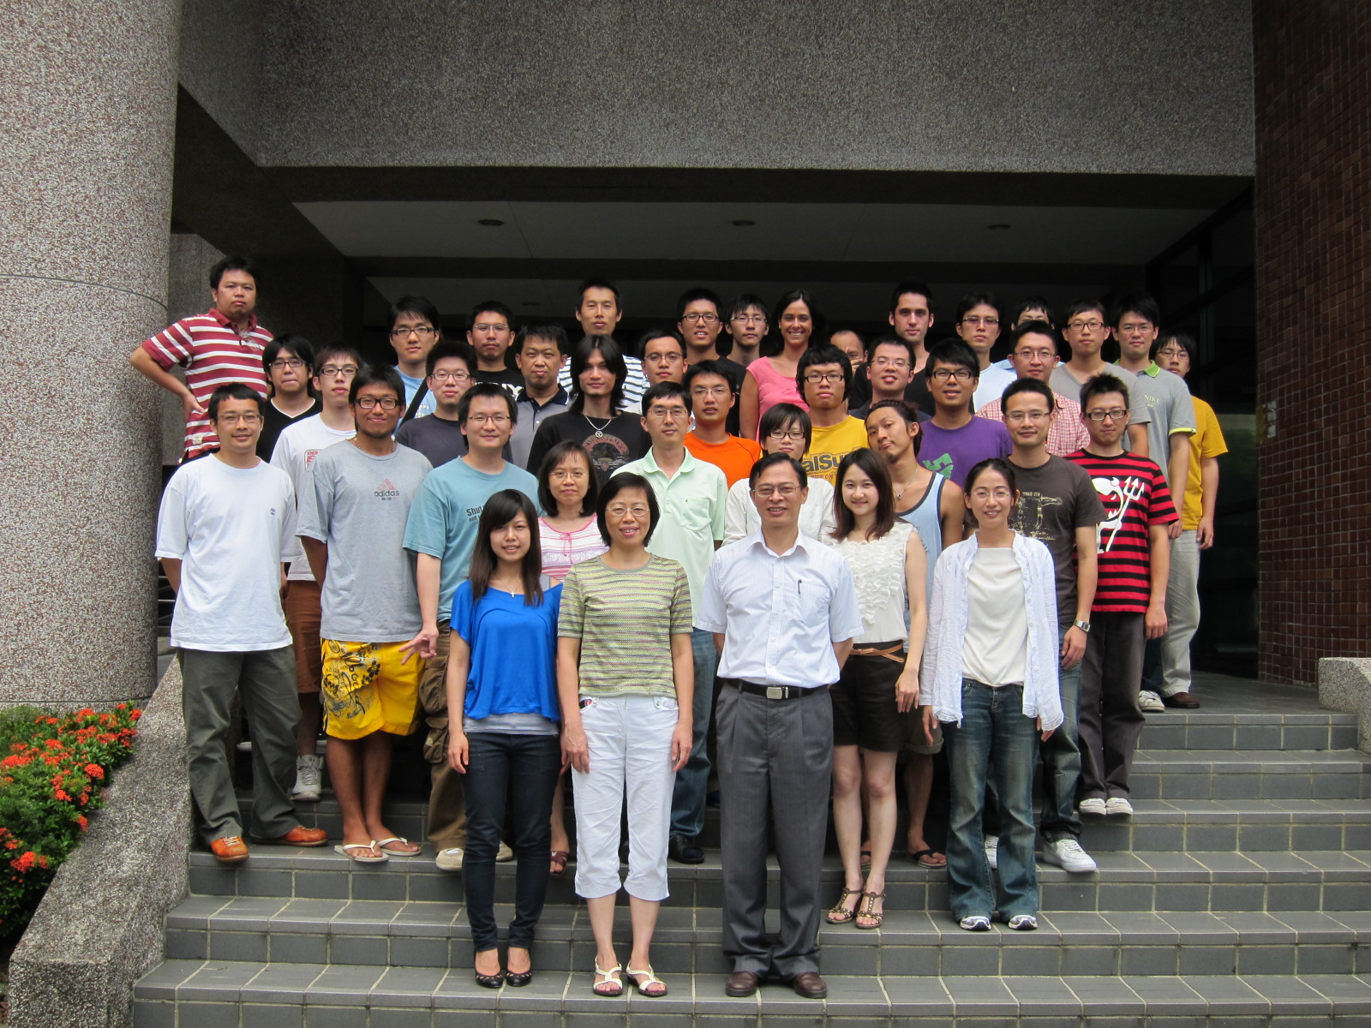

Slide 42
Thank you for your attention

Slide 43
Hybrid Approach?
People have been talking about hybrid approaches for years with little avail.
  Apply machine learning first and then rules as a post-processing step, or the other way around?
  In mathematics one can regard machine learning as an analytical approach, and rule-base as an algebraic approach. The two don’t get along very well much like two incompatible NBA players.
Tides in artificial intelligence have gone through similar changes.

Slide 44
Linguistic Pattern Matching (I)
What kind of patterns to collect?
How to match collected patterns?
  The two issues are closely related
Note that most patterns are not perfect
  The longer (or the more constrained) the more accurate

Slide 45
Outline
An example of text mining
Rule base or machine learning?
Principle-based approach
Modeling context through frames
Examples in biological text mining
What constitutes “understanding”
Principal Pattern Analysis

Slide 46
Modeling context in natural language
Linguistic features are context sensitive: an example of word segmentation
  Probabilistic models tend to assign (or tune) weights to these words and hope the right ones win (but there are numerous cases to look after!)
A better strategy is to analyze when and where “location” (scenario) should appear
We use “frame” to model the context.
  We believe this is a breakthrough in NLP research
遊台
終點
交屋
日期
台 中
烏 日
Long tail effect

Slide 47
Frame prediction
Unknown word detection: inferred from other slots
  我的朋友克里斯朵夫史群費洛從美國來訪
(my) (friend) (Christopher Stringfellow) (from) (US) (visit)
  Longer stable frame can infer shorter unstable ones
Error correction: use frame dictionary the same way as you would a word dictionary in Spellchecker
  e.g. You must know much to tell the difference
  You must be knowledgeable to tell the difference
  (the frame of “knowledgeable”:
    having a lot of knowledge;
    knowing a lot
  Named entity recognition, grammar, style checker
Top-down inference
Notes:
Unknown word validation can be done in a separate program
Frames are matched in the order of their degrees of stability and their length
Short unstable frames would wait for longer stable ones to infer them

Slide 48
Our knowledge representation system
- InfoMap
InfoMap has been developed in our lab for 14 years.
  Originally designed for Q&A and NER.
  A frame structure for concept representation
  E-HowNet (extended HowNet) ontology is built in.
  Uses template matching for hierarchical inference.
Frame matching: scoring and prediction algorithm
  to replace the exact template matching
Inference Engine

Slide 49
Automatic frame acquisition through statistical learning
Knowledge is the key to the success of this approach (the same as human being)
  More frames, composition rules (scoring)
Find collocated words or senses from annotated corpus (e.g. NER)
  Simpler than finding template patterns. The latter needs to consider exact frequent strings, which is difficult when there are multiple labels or imprecise wording.
  Collocated N-tuples can be clustered. Relations can be deduced by ordered collocations.

Slide 50
Outline
An example of text mining
Rule base or machine learning?
Principle-based approach
Modeling context through frames
Examples in biological text mining
What constitutes “understanding”
Principal Pattern Analysis

Slide 51
Text Mining in Biomedical Sciences
Pubmed contains millions of articles and is increasing rapidly.
Many articles are interrelated (the same protein might have been discussed in humans, rats and etc.).
Any question a biologist is interested in might require the reading of hundreds of (relevant or irrelevant) papers.
A search engine smarter than GOOGLE is required to help biologist

Slide 52
Named Entity Recognition (NER) and Relation Extraction in Biology
Gene (protein) name Recognition is vey important.
Protein-protein interaction and Gene-disease relations are the central theme
These tasks turn out to be extremely difficult.

Slide 53
Difficulties of Gene NER (I)
Authors often do not use the official gene symbols
  interleukin 21 (IL21)
Genes have synonyms
  HslV (ClpQ)
  HslU (ClpY)
Use of full gene names and/or gene symbols/acronyms
Notes:
IL21 is offical symbol, interleukin 21 is possible gene name.

Slide 54
Difficulties of Gene NER (II)
Gene names/medical terms ambiguity
  STS : steroid sulfatase [gene name]
  STS : serologic test for syphilis [medical term]
Gene names/common English words ambiguity
  virus-induced signaling adapter/VISA
Alternative typographical variants
  alpha-2-macroglobulin
  α-2-macroglobulin
Ambiguity between protein names and their protein family names
  CLP (protein name or its family?)
Notes:
STS, Official gene name: steroid sulfatase (microsomal), isozyme S [Homo sapiens]
命名的由來 : steroid sulfatase
STS serologic tests for syphilis 梅毒血清學試驗

Slide 55
Variation in Expression
The name explains its function (appositive)
  the Ras guanine nucleotide exchange factor Sos
  the Ras guanine nucleotide releasing protein Sos
  the Ras exchanger Sos
  the GDP-GTP exchange factor Sos
  Sos(mSos), a GDP/GTP exchange protein for Ras

Slide 56
Named entity frame example: protein name
Interleukin 1 (IL-1)-reponsive kinase
epidermal growth factor receptor or EGF receptor or EGFR
the Ras guanine nucleotide releasing protein Sos
  the GDP-GTP exchange factor Sos
SH2 and SH3 domains of Src
Partial matching is useful here
  We need some indication that a gene is possibly here so that external frame could be applied

Slide 57
Relation Extraction is even harder
An active P1 must therefore, presumably by activation of P2, cause dissociation of P3 and P4 by modifying P4.
  An active P1 activates P2.
  The active P1 modifies P4.
  The active P1 dissociates P3 and P4
Such a representation of a sequence of reactions is not easy to identify by ordinary pattern-matching methods.
Notes:
三件事實的描述放在同一個句子中，這類的句型很難用單一的 template 做 pattern-matching

Slide 58
Outline
An example of text mining
Rule base or machine learning?
Principle-based approach
Modeling context through frames
Example in biological text mining
What constitutes “understanding”
Principal Pattern Analysis

Slide 59
What constitutes understanding?
For computers to help us perform routine task or answer simple questions, the level of understanding depends on question granularity.
  Can evaluate computer through question & answering system
  How many question types can your computer differentiate? (500? 5000?)
    The ability to extract answers from text is crucial
  IBM Jeopardy contest

Slide 60
Interact with domain experts
Machine learning: one shot deal
  Domain experts provide the annotation and leave. Then engineers take over
Ours:
  Domain experts go through basic training in informatics
  Computer scientists provide all useful tools
  Domain experts Perform the annotation task hierarchically and interactively using these tools
Text mining is an interdisciplinary task, so will people be trained that way.

Slide 61
Collocated Words
Two consecutive collocated words form a bi-gram.
Several collocated words with certain precedence constraints could form a structured frame.
A collection of collocated words (e.g. from an ontology) could indicate the existence of a certain concept (e.g. a gene name).

Slide 62
Understanding is the ability to identify context
Context由粗到細有層次的差別，就像地圖一樣。在不同context使用的詞彙集也不一樣。
同樣地，理解也有層次的差別。
  中央研究院在哪裡？
  中央研究院資訊所在哪裡？
  台灣有哪些好玩的地方？
  台北市有哪些好玩的地方？
  西門町有哪些好玩的地方？

Slide 63
Outline
An example of text mining
Rule base or machine learning?
Principle-based approach
Modeling context through frames
Example in biological text mining
What constitutes “understanding”
Principal Pattern Analysis

Slide 64
Chinese language representation and understanding
Objective: Design a knowledge-based system to represent Chinese language that can facilitate object and relation recognition in Chinese text.
Technical challenges:
  Unknown word identification (no word boundary)
  Deep semantic analysis (Chinese grammar is loose)
  Fine-grained knowledge Incorporation
Significance and impact: This design can help set up a never-ending learning system for named entities and relations on the web
Notes:
People in AI have been evading the question of “understanding.”We believe this should be carried out in stages. Here, “understanding” refers to objects (noun phrases) and the relations among them.
The secret of understanding lies in good representation.

